Slide 1
The Ormiston Park Academy’s
Robust Reading

Slide 2
KS3 Robust Reading
What genre do you think this book belongs to? (e.g., mystery, fantasy, romance, etc.)
What can you infer about the book from the cover? (Colors, images, fonts, etc.)
Who do you think would enjoy reading this book?
Let’s read the blurb together
What do you think might happen in the book based on what we have just read?

Slide 3
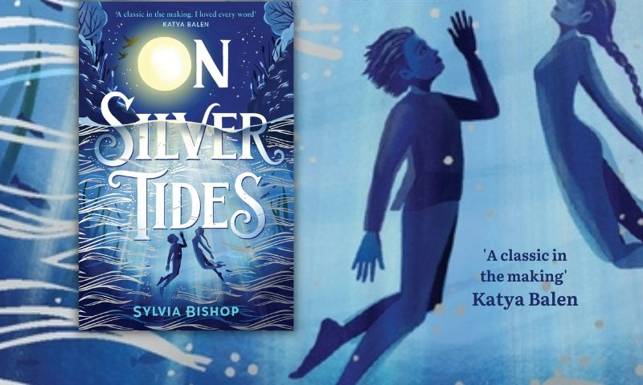
Year 7

Slide 4
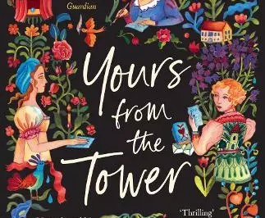
Year 8

Slide 5
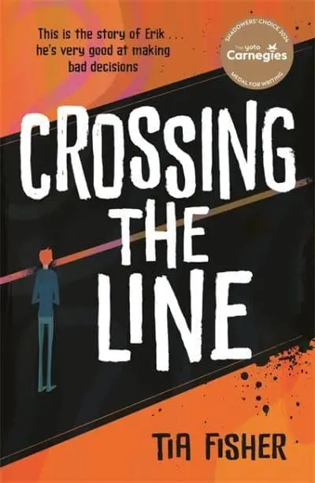
Year 9

Slide 6
Whilst we read, we will be stopping to do the following; questioning, predicting, summarizing and clarifying.

Slide 7
Whilst we read, we will be stopping to do the following; questioning, predicting, summarizing and clarifying.

