Slide 1
Year 9 Options Guide
2022 - 2024

Slide 2
Option Guide
Welcome to your options guide. The aim of this guide is to help you select the right subjects for your KS4 (Y10-11) studies which will begin when your return in September to start Year 10. Our KS4 curriculum offers all students the opportunity to gain a minimum of nine qualifications at GCSE, BTEC or Vocational Level 2 Certificates or Awards.
Which subjects will I study at Key Stage 4?
The Core Curriculum
All students will study a Core Curriculum of six GCSEs:
English Language and English Literature
Mathematics
Triple Science (three GCSE qualification)
Students also continue a core Physical Education (PE) programme and undertake Personal, Social, Health Education (PSHE).
Additional accreditation/qualifications may also be available within these programmes over the two years of study.
The Option Pathways
There have been many changes implemented recently with respect to both the qualifications available to students and the expectations of the study programmes that schools and Academies should offer by the Government. These have all been aimed at securing higher standards of education for students.
A great deal of effort and thought has gone into considering how best to provide for our students, not only in securing them success into KS4 but also offering progression routes forward through Sixth Form/Apprenticeships to University/Employment. We are delighted this year to be able to offer two pathways for our students to choose from, Our Believe route which is aimed at students who should/could complete a traditional EBACC route which would include a traditional humanities subject and/or French. Achieve is a traditional pathway selecting from EBACC route and a wider range of GCSE subjects. Both routes offer students a broad, varied and creative selection of choices which ensures all destinations options are available and coursework workload is managable in year 11.
We have thought carefully about the progress students have made in Years 7, 8 and 9. Using this information, as well as information about the levels your child reached at primary school, we have decided which subjects will be available to your child within the pathway you have been allocated.

Slide 3
Option Pathways
Pathway | Option Choices
Believe | Pick One From: History GCSE Photography VOC Child Development VOC Music VOC Hospitality & Catering VOC Creative iMedia VOC | Pick One From: Geography GCSE Sociology GCSE Art VOC Engineering VOC Performing Arts VOC Sport Studies VOC | Pick One From: French GCSE Dance VOC Child Development VOC RE GCSE Art VOC Business Studies VOC
Students in the Believe Option Block must select at least one subject from French or history or geography.
Pathway | Option Choices
Achieve | Pick One From: History GCSE Photography VOC Child Development VOC Music VOC Hospitality & Catering VOC Creative iMedia VOC | Pick One From: Geography GCSE Sociology GCSE Art VOC Engineering VOC Performing Arts VOC Sport Studies VOC | Pick One From: French GCSE Dance VOC Child Development VOC RE GCSE Art VOC Business Studies VOC
Students in the Achieve Option Block must select at least one subject from French or history or geography or sociology or RE.
Note: This will allow all students to explore a broad and balanced curriculum and ensure that coursework workload does not become unmanageable in year 11.

Slide 4
Core Curriculum
Compulsory for ALL students
English Language
English Literature
Mathematics
Triple Science

Slide 5
Biology GCSE
Examination Board
AQA
Biology Graded: 1-9
Exams: There are two exams for biology.
100 marks each. Both weighted
50%
Paper 1: Topic 1-9
Paper 2: Topics 10-18
How is the course assessed?
100% examined
There are 2 exams for biology.
100 marks each. Both weighted 50%
Dates: The exams take place during May/June in Year 11. Paper 1 takes place in May. Paper 2 takes place in June.
Coursework: No coursework.
Required Practicals: There are also a number of experiments students need to know about. They are not controlled assessments but 15% of the marks in the exam will come from questions about these practical’s.
Math’s : 10% of the marks in both papers come from Mathematical questions
Topics Studied:
Cell Structure
Enzymes & the Digestive System
Infection & Response
The Nervous System
The Endocrine System
Bioenergetics
Ecology
Inheritance & Genetics
All students at OPA follow the Triple Science pathway and will achieve a GCSE in each discipline:
Biology
Chemistry
Physics
Post sixteen progression routes.
The majority of sixth forms and colleges will want students to have a minimum of grade 6 in the Science if they are to continue to studying them at A level.
Studying Science at A level can lead to exciting careers in STEM industries as well as higher education courses at university

Slide 6
Chemistry GCSE
Examination Board
AQA
Graded: 1-9
Exams: There are two exams for Chemistry (100 marks each). Both weighted 50%
Paper 1 : Topics 1-7
Paper 2: Topics 8-15
How is the course assessed?
100% examined
There 2 exams for Chemistry 100 marks each. Both weighted 50%
Dates: The exams take place during May/June In Year 11.Paper 1 takes place in May. Paper 2 takes place in June.
Coursework: No coursework
Required Practicals: There are also a number of experiments students need to know about. They are not controlled assessments but 15% of the marks in the exams will come from questions about these practical's .
Maths: 20% of the mark in both papers come from mathematical questions.
Topics Studied:
Atoms, Elements, Molecules & Compounds
The Periodic Table; Patterns & Trends
Ionic, Metallic and Covalent Bonding
Quantitative Chemistry
Energy Changes
Rates of Reaction
Extraction of Metals
Environmental Chemistry
Organic Chemistry
All students at OPA follow the Triple Science pathway and will achieve a GCSE in each discipline:
Biology
Chemistry
Physics
Post sixteen progression routes.
The majority of sixth forms and colleges will want students to have a minimum of grade 6 in the Sciences if they are to continue to studying them at A level.
Studying Science at A level can lead to exciting careers in STEM industries as well as higher education courses at university

Slide 7
Physics GCSE
Examination Board
AQA
Grade: 1 – 9
Exams: There are 2 exams for Physics. 100 marks each. Both weighted 50%
Paper 1: Topics 1-4
Paper 2: Topics 5-8
Dates: The exams take place during May/June in Year 11. Paper 1 takes place in May. Paper 2 takes place in June.
How is the course assessed?
100% examined
There are two exams for physics.
100 marks for each. Both weighted 50%
Coursework: No coursework
Required Practicals: There are also a number of experiments that students need to know about…..15% of the marks in the exam will come from questions about these practicals.
Maths: 30% of the mark in both papers come from mathematical questions.
Topics studied:
Energy
Electricity
Particle Model
Atomic Structure & Radioactivity
Forces
Waves
Magnetism & Electromagnetism
Space
All students at OPA follow the Triple Science pathway and will achieve a GCSE in each discipline Biology, Chemistry and Physics
Post sixteen progression routes.
The majority of sixth forms and colleges will want students to have a minimum of grade 6 in the sciences if they are to continue to study them at A level.
Studying Science at A Level can lead to exciting careers in STEM industries as well as higher education courses at university.

Slide 8
English Language GCSE
Examination Board
AQA
The AQA GCSE Language Qualification:
Develops students' reading and writing skills.
Allows students to read and enjoy a variety of short texts from both the 19th and 20th century.
Develops students’ critical understanding of non-fiction texts.
Affords students the opportunity to discuss a wide range of non-fiction topics.
How is the course assessed?
50% Reading and Writing Fiction Exam
50% Reading and Writing Non-Fiction Exam
This qualification covers:
English Language Paper 1: Reading and Writing Fiction
English Language Paper 2: Reading and Writing Non-Fiction
Spoken Language Component
Main benefit of the qualification
A GCSE in English Language is mandatory for admission to almost all jobs and courses. The majority of courses expect at least a grade 5 at GCSE (a 'good' pass) and many expect a grade 6 or above. More broadly, a sound understanding of English language is vital to a successful personal and professional life.
Post sixteen progression routes.
Most post 16 courses require at least a grade 5 in English. Students that do not achieve a grade 4 will need to resit.

Slide 9
English Literature GCSE
Examination Board
AQA
The AQA GCSE Literature Qualification:
Develops students' reading and writing skills.
Allows students to read and enjoy a variety of plays, poems and novels from 17th century to the present day.
Develops students’ critical understanding of their own world and those around them.
Affords students the opportunity to discuss a wide range of non-fiction topics.
How is the course assessed?
English Literature Paper 1 Exam: Macbeth and Jekyll and Hyde (40%)
English Literature Paper 2: An Inspector Calls and Poetry (60%)
Suitable candidates?
English Literature is compulsory.
This qualification covers:
Shakespeare: Macbeth
19th Century Text: A Christmas Carol
Modern Play: An Inspector Calls
Poetry: Power and Conflict Anthology (Inc. Seamus Heaney, William Wordsworth, Carol Ann Duffy etc.)
Unseen Poetry
Main benefit of the qualification
A GCSE in English Literature helps students to improve vital literacy skills and to understand and interpret the world around them. Successful completion of the English Literature GCSE can lead to a career in law, journalism, advertising, business and many other areas.
Post sixteen progression routes.
Most post-16 courses require at least a grade 5 in English. English Literature is an excellent A Level that is particularly applicable to careers in law, journalism, publishing, business or teaching.

Slide 10
Mathematics GCSE
Examination Board
EDEXCEL
Mathematics is a fundamental part of human thought and logic, and helps us in understanding the world and ourselves. It forms a crucial part of day-to-day life as adults, enabling us to manage our finances and provide for our future.
Mathematics provides an effective way of building mental discipline and encourages logical reasoning and mental rigor.
How is the course assessed?
100% Exam
Three exam papers
Paper 1 Non Calculator,
Papers 2 and 3 Calculator
Skills developed:
Algebra
Ratio
Proportion
Rates of change
Geometry
Measures
Probability
Statistics
Higher Maths
Post sixteen progression routes.
A good GCSE grade in Maths can lead to
A level Maths
Possible Career paths: Studying Mathematics can make a significant contribution to any job that requires calculations, from office work to careers in banking or retail. Maths develops the skills of reasoning and problem solving.

Slide 11
Curriculum Options

Slide 12
ART-BTEC
Examination Board
EDEXCEL
How is the course assessed?
The Edexcel BTEC Art course is a vocational related qualification developing knowledge and understanding by applying learning to work related context.
Skills developed include:
Team working
Exploring materials and processes
Designing for final outcomes
Working from a brief
Working to deadlines
Presenting work
Creative and practical research projects
Contextual references in Art and Design
There are four Units
Three internally set units
One Externally set unit with an Exam at the end
All work is course work based and assessed on Levels Pass, Merit and Distinction.
Suitable candidates?
If you love drawing, designing and researching then ART is the course for you.
Post sixteen progression routes.
BTEC Level 2 can lead into higher education courses such as
A Level and BTEC level 3.
A qualification in Art leads into many job opportunities, some of these include:
Graphic design
Fine Art
Fashion and Textiles
Architect
Illustrator
Art administrator
Teacher
Photographer
Stage/set design

Slide 13
Business-NCFE
Examination Board
It is designed for learners who want an introduction to business and enterprise that includes a vocational and project-based element. The qualification will appeal to learners who wish to pursue a career in the business and enterprise sector or progress onto further study.
This course is an equivalent to 1 GCSE.
How is the course assessed?
40% Externally assessed written exam
60% Internally assessed synoptic project
This qualification shows learners how to:
understand entrepreneurial characteristics and business aims and objectives
legal structures, organizational structures and stakeholder engagement
understand the marketing mix, market research, market types and orientation types
understand operations management
understand internal and external influences on business
understand research, resource planning and growth for business
understand human resource requirements for a business start-up
understand sources of enterprise funding and business finance
understand business and enterprise planning.
Suitable candidates?
This qualification is designed for learners who want an introduction to business and enterprise that includes a vocational and project-based element.
Post sixteen progression routes.
Level 3 Applied Generals in:
Enterprise and Entrepreneurship
Financial Studies
Business and Enterprise
Applied Business
Business.
Level 3 Technical Levels in:
Coordinating Business Support
Business: Marketing.

Slide 14
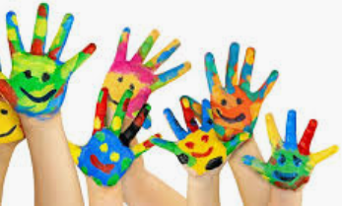
Child Development and Care-NCFE
Examination Board
CACHE
The Cache Level 2 Award in Child development & Care will give you a fantastic understanding of childcare and development in the early years Sector of children from 0 to 5 years of age. It will be beneficial to anyone considering a career in Early Years or Primary teaching and supports progression to a Level 3 vocational or academic childcare, Psychology, Health & Social Care subjects or an apprenticeship. You will have opportunities to achieve an A*- D and it is equivalent to one GCSE.
How is the course assessed?
Coursework=50% of grade
Unit 1: An introduction to working with children aged 0-5 years Assignment- graded A* - D
External examination=50%
Childcare & Development 0-5 years Examination: Must achieve a pass
The skills and knowledge acquired will be relevant and transferable to other settings and provides enhanced career opportunities and a satisfying course of study for candidates of various ages and diverse backgrounds who may not progress to further study of the subject.
Students will learn:
An awareness of learning styles
An introduction into working with children in a variety of settings
An understanding of roles and responsibilities when working in a setting
An understanding of equality and diversity within a childcare setting
An understanding of the stages and sequence of child development
An introduction to the influences that affect holistic development
An introduction to everyday care routines and the types of activities that can support the development of independence
An understanding of how to support children through transitions in their lives.
Suitable candidates?
Suitable for candidates who wish to develop their knowledge and understanding of children both practically and academically.
Post sixteen progression routes.
Early years careers
Primary/secondary teaching
Level 3 vocational or academic Childcare
A Levels in Psychology
Health and Social care s
A range of apprenticeships
Career Options:
Nursery Nurse, Midwife, Child Psychologist, Paediatrician, Teacher, Family Support Worker, Teaching Assistant, Social Worker, Youth Worker, counsellor

Slide 15
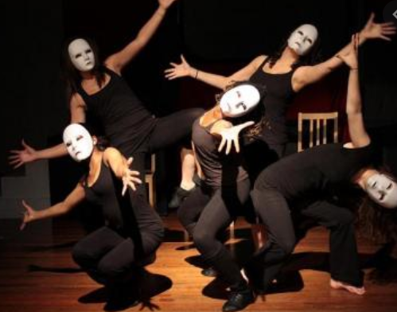
Creative & Performing Arts (CAPA) Drama-RSL
Examination Board
RSL 2
The Creative and Performing Arts Level 2 Drama course is a hands-on approach to creating, rehearsing and performance.
This course is an equivalent to 1 GCSE.
Course: RSL Level 2 Certificate in Creative and Performing Arts: Drama Areas of study: Unit 201: Live Performance (Core)
Unit 206: Acting for Camera (Optional)
Unit 212: Performing Text (Optional)
Unit 220: Working with masks or puppetry (Optional)
Unit 219: Vocal Techniques - Acting (Optional)
Assessment: Throughout the course, students are expected to work as a professional theatre company, creating and performing pieces in regular showcases. Practical assessment will take place both within lessons and through the participation in performance showcases. Written assessments will take the form of rehearsal diaries, in-depth self-evaluations and controlled assessments.
How is the course assessed?
100% Coursework– There is NO written exam. Coursework includes:
Live Performance in front of an audience
Planning, rehearsing and evaluating
Suitable candidates?
If you want to develop your acting skills and enjoy performing then this is the course for you.
Post sixteen progression routes.
As part of the RSL course, students will complete an externally assessed core unit (201 Live Performance) which takes the form of a controlled assessment, involving the planning, execution and evaluation of a practical exam task. In addition to the core unit, each qualification includes a range of optional units as detailed above.
Important course information: Students will be expected to perform in front of a range of audiences as part of the assessment process. Students will cover a diverse range of acting styles and must participate in all workshops.
Students will be expected to track their own progress in the form of written evaluation, a video diary/ blog, and set their own targets.
BTEC National Diplomas (in performance)
Musical Theatre
Drama/ Performing Arts BTEC level 3/ A/AS level.
Acting course/ Drama School

Slide 16
Creative iMedia (ICT)-OCR
Examination Board
OCR
The OCR Cambridge National Certificate in Creative iMedia is designed to:
Equip learners with a range of creative media skills and other transferable skills such as project management skills, team working etc
Help learners to use skills to create fit-for-purpose creative media products.
Employ a hands-on approach in the learning of a range of creative products such as Website creation, Digital animations, Digital graphics and many more.
How is the course assessed?
25% external assessment
1 hour examination.
75% internal assessment 3 projects.
Suitable candidates?
The course is suitable for all students. However, students who are keen to spend additional time on their projects outside of lessons tend to achieve better results.
This qualification covers:
Unit R081 - Pre-production skills
(Examination unit)
Unit R082 - Creating digital graphics
(Internally assessed project
Unit R085 - Creating Multi-page website
(Internally assessed project)
Unit R087 – Creating interactive multimedia product
(Internally assessed project)
Main benefit of the qualification
The biggest advantage of this qualification is that fact that it is weighted heavily on internally assessed projects. 75% of the course is based on 3 projects that are completed over 2 years. The remaining 25% is assessed through an examination. Due to the large weighting of the coursework, it is technically possible to pass the course on just the projects.
Post sixteen progression routes.
Successful completion of this qualification will lead a number of pathways including:
Level 3 Apprenticeship
Cambridge Technical in IT and Digital Media
GCE in Media Studies

Slide 17
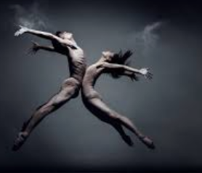
Dance-RSL
Examination Board
RSL 2
Throughout this course, students are expected to work as a professional dance company, creating and performing pieces in regular showcases. Practical assessment will take place both within lessons and through the participation in performance showcases. Written assessments will take the form of technique diaries, in-depth self-evaluations and controlled assessments. ​
How is the course assessed?
No written exam
100% Coursework (2 x units)
Live performance is externally assessed
1 optional unit internally assessed
RSL Level 2 Certificate in Creative and Performing Arts: Dance Area of Study:
Unit 201: Live Performance (Core)
Unit 222: Choreography (Optional)
Unit 227: Dance Technique and Performance (Optional)
Unit 229: Ensemble Dance Performance (Optional)
Unit 230: Global Dance Styles (Optional)
As part of the RSL course, students will complete an externally assessed core unit (201 Live Performance) which takes the form of a controlled assessment, involving the planning, execution and evaluation of a practical exam task. In addition to the core unit, each qualification includes a range of optional units as detailed above.
Suitable candidates?
Only students who are confident of performing publicly should take this course. If you are not willing to perform in front of an audience, this is not the course for you.
Post sixteen progression routes.
Dance level 3 AS/ A level dance
Musical Theatre
RSL Dance Syllabi
Theatre
Dance College
Choreography Course
Opportunities: Students will be expected to perform in front of a range of audiences as part of the assessment process. Students will cover a diverse range of dance styles and must participate in all workshops.
There will be a number of performance opportunities throughout this course as well as the opportunity to see live dance and take part in workshops and projects with visiting dance artists. Should students complete the course successfully, they can also go on to complete:

Slide 18
Engineering-RSL
Examination Board
NCFE
NCFE Level 1 / 2 Technical Award in Engineering offers an opportunity to understand the world of engineering through subject based knowledge and practical application in the workshop. The course is equivalent to 1 GCSE.
How is the course assessed?
Throughout the course you will gain valuable knowledge in the following areas:
The engineering disciplines
The science and mathematics that are applied in engineering
How to read and create engineering drawings
The properties and characteristics of engineering materials and know how specific materials are used in engineering to create products
Learn how to use engineering tools, equipment and machines in workshops and how this relates to the different engineering sectors.
In lesson, you will be expected to build subject knowledge through theory work, practical work and problem solving. The practical element of this course enables you to build your skills whilst preparing you for the synopsis investigation.
This course is a vocational based qualifications that gives a platforms to spark an interest in the world engineering. The course combines some of the traditional practical elements with technical problem solving.
40% Exam paper
60% Synoptic Project which includes :
Investigation of a brief
Engineers Drawings to scale
Practical outcome
Suitable candidates?
If you like problem solving, being creative, and understanding how things work then this is the subject for you!
Post sixteen progression routes.
A level Design and Technology
Level 3 Applied General Engineering
Level 3 Technical Level in Engineering
An Apprenticeship sector in engineering from anything, such as Aerospace Engineering to Electrical Support engineering or Engineer.

Slide 19
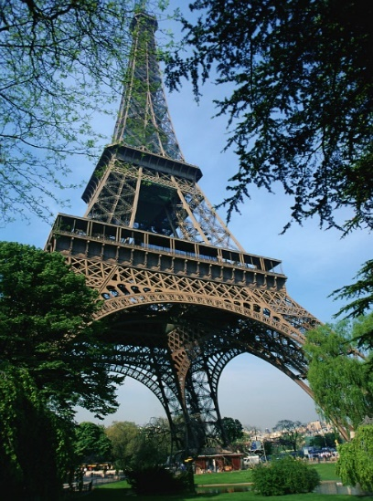
French-GCSE
Examination Board
AQA
AQA GCSE French course is to develop the ability to communicate effectively in French, through both the spoken and written word.
Broad based skills included are:
Listening skills
Reading skills
Writing skills
Speaking skills
How is the course assessed?
There are 4 skills to cover, with assessment points in Year11 speaking, writing, reading and listening
Listening 25%
Reading 25%
Speaking 25%
Writing 25%
Students will be encouraged to develop understanding of the spoken and written forms of French in a range of contexts. Students will develop the ability to communicate effectively in French, through both the spoken and written word, using a range of vocabulary and structures. Students will develop knowledge and understanding of the grammar of French and the ability to apply it.
Students will apply their knowledge and understanding in a variety of relevant contexts which reflect their previous learning and maturity. Students will develop knowledge and understanding of countries and communities where French is spoken and develop positive attitudes to French learning whilst being provided a suitable foundation for further study and/or practical use of French.
Suitable candidates?
If you are interested in different cultures, love learning French , have a positive attitude, then this is the course for you.
Post sixteen progression routes.
This could lead to job opportunities aboard, A level French and a possible career as a translator.

Slide 20
Geography-GCSE
Examination Board
AQA
A new, re-designed qualification that is engaging and relevant to today’s geographers, that has a clear structure, is enquiry based, has a real world focus and which gives the opportunity for fieldwork.
How is the course assessed?
Areas studied:
Paper one- Living with the physical environment
The Challenge of natural hazards
Tectonic Hazards
Weather Hazards
Climate Change
Living World
Ecosystems
Tropical Rainforest
Hot Deserts
Physical Landscapes
Coastal Landscapes
River Landscapes
Paper two- Challenges in the human environment
Urban Challenges
Urban growth in Nigeria
Urban Challenges in the UK
Sustainable development of urban areas.
The changing economic world
Economic development and quality of life.
Reducing the global development gap.
Economic Development in Nigeria.
Economic Change in the UK
The challenge of Resource Management
Global resource management
Resources in the UK
Energy
Paper Three - Geographical Applications
Issue evaluation – pre released exam booklet
Fieldwork and geographical enquiry
Main benefit of the qualification
While the course is 100% exam based the units are broken down into manageable chunks, with specific case studies assigned to each unit so it is easier to relate to the theory work learnt.
100% Examination
3 exam papers
Questions involve a selection of one mark and multiple choice questions – describe, state, identify.
Four mark questions (longer answer) – explain
Six, nine, fifteen mark questions (longer answer) – assess, evaluate, to what extent, justify
Suitable candidates?
The course is suitable for all students, but a passion for the subject really does help.
Post sixteen progression routes.
Successful completion of this qualification will lead to a number of paths including:
A Level Geography
Travel and Tourism
Potential Careers include:
Environmental Management, Pilot, Secondary School Teacher, Journalist

Slide 21
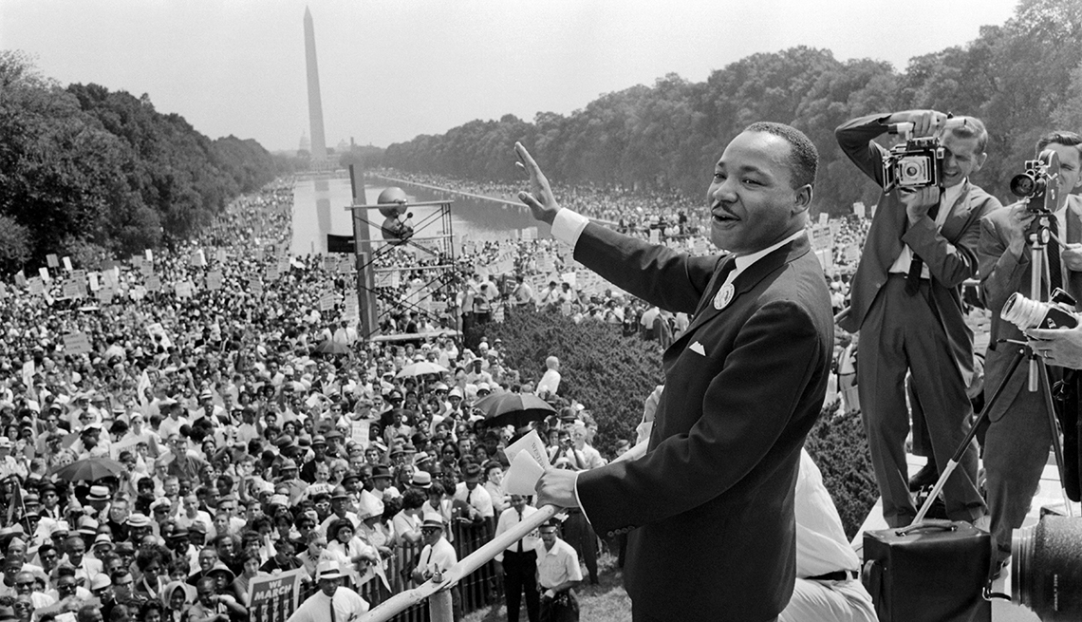
History-GCSE
Examination Board
EDEXCEL
How is the course assessed?
The Edexcel GCSE History course develops students ability to; communicate effectively an understanding of causes, consequences, the importance of past events and to be able to explain their points through writing; analysing historical sources and forming evidence based judgements.
Broad based skills included are:
Listening skills
Analysis skills
Judgement skills
Reading skills
Writing skills
Four topics are studied, with a paper sat for each one.
Crime and Punishment – 6 questions. 52 marks. 30%
Henry VIII and his Ministers – 3 questions. 32 marks. 20%
Cold War – 3 questions. 32 marks. 20%
USA 1954-75. Civil Rights and Vietnam – 5 questions. 32 marks. 30%
Suitable candidates?
If you love learning History and have a positive attitude, then this is the course for you.
Post sixteen progression routes.
Academically History is linked to other subjects such as Art, Geography, Religious Studies, and Sociology to name but a few. Further study options with a History GCSE are History, Law and Politics. Career options after studying History are:
Journalism
Law
Business
Politics
Archaeology
Marketing
Teaching.

Slide 22
Hospitality and Catering-WJEC
Examination Board
WJEC/EDUCAS
Level 1/2 Hospitality and Catering offers the opportunity to build upon and develop skills in the kitchen whilst learning about the Hospitality and Catering environment and industry.
Throughout the course you will have the opportunity to gain valuable skills and knowledge in the following areas:
An understanding of the Hospitality and Catering industry
Develop the ability to plan, prepare and cook different dishes
Develop the practical skills required within the catering industry
Complete tasks that mirror industry practices.
In lessons you will be expected to build your subject knowledge through theory work, practical work and dish preparation. The practical element of the course enables you to develop your skills whilst preparing you for the practical exam element of the course
This course is vocational based qualification that gives a platform to spark an interest in the world of Hospitality and Catering. The course combines some of the traditional practical elements with industry skills and techniques that could lead the way into a professional kitchen or catering environment
How is the course assessed?
40% Exams & 60% Synoptic Project which is split into two units:
Unit 1 – The Hospitality and Catering Industry
Unit 2 - Hospitality and catering In Action
Suitable candidates?
If you have a love of cooking and an interest in learning more about the Hospitality and Catering Industry, then this is the course for you!
Post sixteen progression routes.
Level 3 Applied Certificate / Diploma is Food Science and Nutrition
Level 2 / Level 3 Diploma in Hospitality and Catering
Level 2 /Level 3 Diploma In Professional Cooking Level
Level 3 Diploma In Hospitality and Tourism Management
An Apprenticeship in the Hospitality and Catering Industry

Slide 23
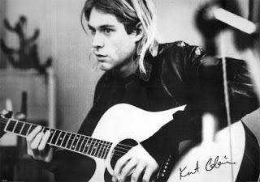
Music-RSL
Examination Board
RSL 2
PERMORMANCE FOR MUSIC PRACTIONERS
A hands-on approach to music making, rehearsing and performance. This course is an equivalent to 1 GCSE.
This course is structured in a way to offer students choices based on musical preferences and the popular music industry.
Core Units relating to Music knowledge and live music performance and an optional unit of music sequencing and composition. This will provide students the chance to develop their skills through various projects.
How is the course assessed?
100% Coursework– this includes:
Live Music Performance
Organising a music event
Music style development
Suitable candidates?
Students can choose to learn to play an instrument, sing, compose, sound record and create digital music.​
Pupils will be encouraged to create music and participate in performances, create their own performances and events while developing and understanding of the promotional and technical demands involved .​
​
Broad based skills included are: ​
Rehearsing, ensemble and band work ​
Listening skills​
Performance skills​
Organising a music event or gig ​
This course is a hands-on approach to music, where you will be performing and rehearsing for the majority of the course. You will be expected to track your own progress in the form of a video diary/ blog, and set your own targets.
If you play an instrument, love performing and practicing, or you may enjoy creating or writing music, then this is the course for you.
I
Post sixteen progression routes.
RSL LEVEL 2 CERTIFICATE IN PERMORMANCE FOR MUSIC PRACTIONERS
BTEC National Diplomas (in Music,
Popular Music and Music Technology)
Rock School Level 3 Certificate
Performing Arts BTEC/ A level.
Music Colleges
BIMM
MGA Academy
Brit School

Slide 24
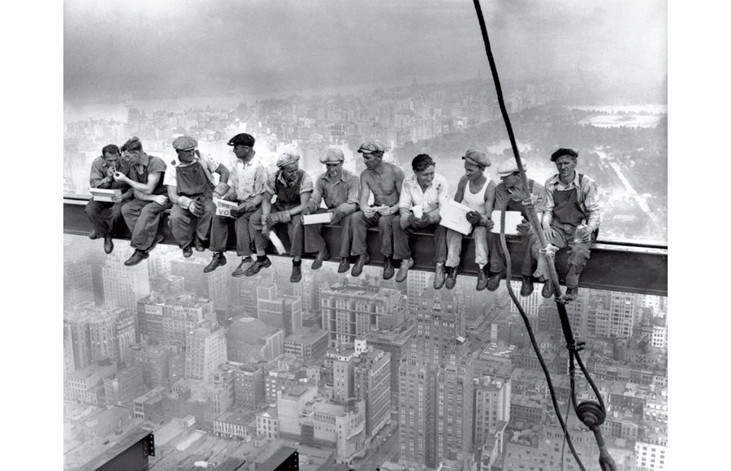
Photography-Pearsons
Part of the exam board's Art and Design courses.
Students will apply their technical understanding, which they develop throughout the course when taking and editing photos for their portfolio. They must be able to justify the techniques they have used, referencing the technical terminology taught to them.
Portfolio - internally assessed unit
This component allows students opportunities to:
develop and explore ideas
research primary and contextual sources
experiment with media, materials, techniques, and processes
present personal responses to themes set by the centre.
Externally assessed unit
The Externally Set Assignment (ESA) represents the culmination of the GCSE course as it draws together all the knowledge, understanding and skills developed in their portfolio.
It usually takes places over two days, providing 10 hours altogether.
Students complete preparatory tasks in the weeks leading up to the ESA.
Examination Board
Edexcel/Pearson
How is the course assessed?
60% personal portfolio
40% externally assessed unit
Suitable candidates?
Anyone interested in taking pictures and learning more about how to do so and the process.
I
Post sixteen progression routes.
RSL LEVEL 2 CERTIFICATE IN PERMORMANCE FOR MUSIC PRACTIONERS
BTEC National Diplomas
A-Level Photography
Other vocation Level 3 courses.

Slide 25
Religious Studies-GCSE
Examination Board
AQA A
How is the course assessed?
Through the course students will learn and gain a good understanding of practices, beliefs and other key information about the two biggest religions in the UK – Christianity and Islam.
Students will then look at a range of ethical and moral issues varying from animal testing and abortion to the death penalty and causes of war.
Students will be challenged with questions about belief, values, meaning, purpose and truth, enabling them to develop their own attitudes towards religious, ethical and moral issues.
Students will also gain an appreciation of how religion, philosophy and ethics form the basis of our culture. They will develop analytical and critical thinking skills, the ability to work with abstract ideas, leadership and research skills.
Paper 1: The Study of religions (Christianity and Islam)
50% 1 hour 45 min exam
Paper 2: Philosophical and ethical studies (Relationships, life, peace and conflict, crime and punishment)
50% 1 hour 45 min exam.
Suitable candidates?
If you have strong opinions and an open mind with a willingness to debate topics.
Post sixteen progression routes.
Knowledge of other cultures and world religious beliefs can be useful in many jobs where you are working with the public or communities. These include counselling and social services, marketing, sales and advertising, catering and hospitality, leisure, sport and tourism, retail sales and customer services, education and training, medicine and nursing, and service sector roles.

Slide 26
Sport Studies-RSL
Examination Board
OCR
The Cambridge Nationals in Sport Studies gives learners the opportunity to apply theoretical knowledge about different types of sport and physical activity, skills development and sports leadership to their own practical performance.
They will learn about contemporary issues in sport such as funding, participation, ethics and role models, and sport and the media. Learners will develop an appreciation of the importance of sport locally and nationally, different ways of being involved in sport and of how this shapes the sports industry.
How is the course assessed?
25% external assessment – 1 hour exam, 60 marks
75% internal assessment – 3 units 60 marks each
Suitable candidates?
The qualification will appeal to learners who wish to pursue a career in the sport and leisure industry
This qualifications compromises 4 units:
Contemporary Issues in Sport - looking at issues affecting participation, promoting values, major sports events and NGBs.
Developing Sports Skills - participation in one individual and one team sport, officiating and performance analysis
Sports Leadership – responsibilities, planning & delivering sports activities, evaluating performance.
Developing Knowledge and Skills in Outdoor Activities – different types of activities, the value of participating, plan & participate in activities.
This qualification offers learners the chance to develop different types of skills through largely practical means. The course is also assessed at various points across the 2 years, rather than all at the end.
Post sixteen progression routes.
As Level or A Level PE
Level 3 Applied General Qualifications, such as Sport Studies or Sports Science.
Level 3 Technical Level Qualifications, such as Personal Training, Fitness Services, or Exercise Science.
Apprenticeships, such as health assistants, Fitness instructors, or personal trainers

Slide 27
Sociology-GCSE
Examination Board
AQA
Sociology is the study of human behavior and social structures. The discipline encourages students to explore why humans think and act the way they do. Whilst considering what external factors shape they way we live. The sociological imagination also encourages skepticism, questioning how we should research human behavior. The course will ask question such as: What is the role of the education? Why do people commit crimes? Is inequality inevitable?
Broad based skills included are:
Listening skills Reading skills
Analysis skills Writing skills
Judgment skills Evaluative skills
How is the course assessed?
PAPER 1 (50% of the GCSE):
The sociology of families
The sociology of education
Relevant areas of social theory and methodology
PAPER 2 (50% of the GCSE):
The sociology of crime and deviance
The sociology of social stratification
Relevant areas of social theory and methodology
Suitable candidates?
If you love debating and have a inquisitive mind, then this is the course for you.
Post sixteen progression routes.
Academically Sociology is linked to other subjects such as Psychology, Criminology, Religious Studies, History, Economics and Politics to name but a few.
Career options after studying Sociology are: Journalism • Law • Business • Politics • Police
• Marketing • Teaching. • Social Care.

