Slide 1
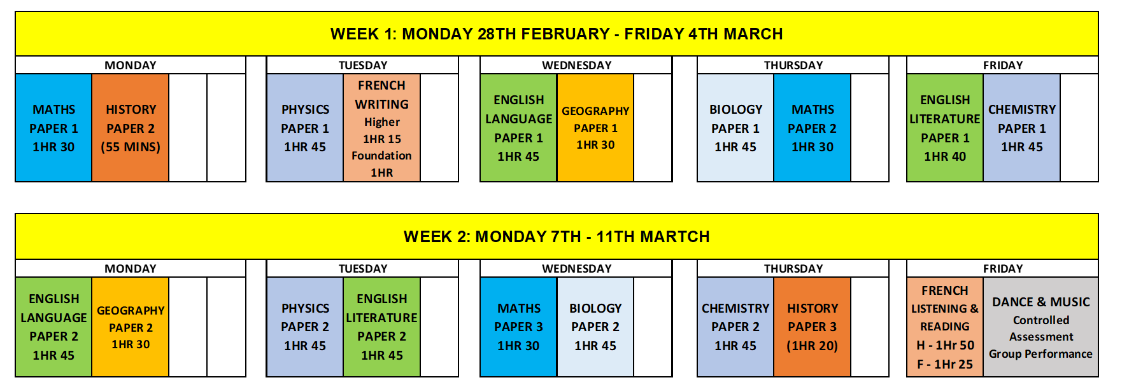
YEAR 11 MOCK 2 - MOCK EXAMS TIMETABLE
NAME: TUTOR GROUP:
Students must still arrive for 8:20am line up each morning, and will finish school at 3pm as usual.
When you do not have an exam, attend all of your normal timetabled lessons.
Mobile phones must be handed over BEFORE entering an exam room. No exceptions.

